Slide 1

In-House Intern

Slide 2
Stand alone and Grid connected Solar PV system And Control by Artificial Neural Network (ANN)
Ishan Budhiraja
2k18/ee/087
Gibson Muyembe
2k18/EE/069

Slide 3
Project analysis slide 2
Table of Contents
1 | Photovoltaic System
2 | Components
3 | Stand Alone PV system
4 | Grid Connected PV system
5 | MATLAB Implementation of Neural Network Based MPPT for Solar PV System
6 | Maximum Power point Tracking
7 | PV Circuit
8 | Neural Network Structure
9 | Collection of Data

Slide 4
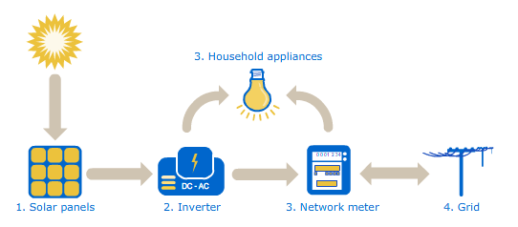
Project analysis slide 2
Photovoltaic System
A photovoltaic (PV) system is composed of one or more solar panels combined with an inverter and other electrical and mechanical hardware that use energy from the Sun to generate electricity.
PV systems can vary greatly in size from small rooftop or portable systems to massive utility-scale generation plants.

Slide 5
Project analysis slide 2
System Components of a PV system
Solar Panels
Electric meters
Inverters
Circuit breakers
Racking
Wiring

Slide 6
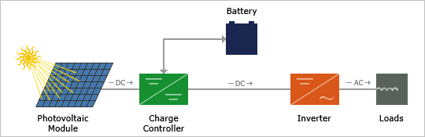
Project analysis slide 2
Stand Alone PV system
Stand-alone systems are not connected with utility power lines and these are self sufficient systems.
These systems could either be used to charge the batteries that serve as an energy storage device or could work directly using the solar energy available in the daytimes.

Slide 7
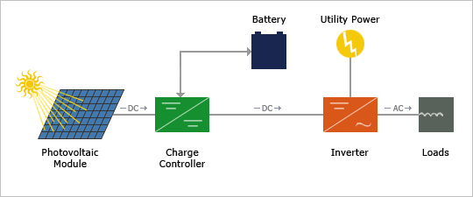
Project analysis slide 4
Grid Connected PV system
A grid connected photovoltaic system will be interacted with utility grid.
The main advantage of this system is that power can be drawn from the utility grid and when power is not available from grid, PV system can supplement that power

Slide 8
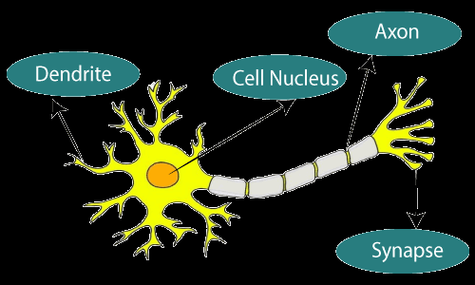
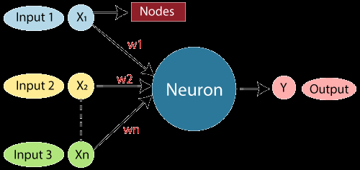
Project analysis slide 4
Artificial Neural Network
"Artificial neural network" refers to a biologically inspired sub-field of artificial intelligence modeled after the brain
Similar to a human brain has neurons interconnected to each other, artificial neural networks also have neurons that are linked to each other in various layers of the networks

Slide 9
Project analysis slide 4
Maximum Power point Tracking
Maximum power point tracking is used commonly with wind turbines and photovoltaic (PV) solar systems to maximize power extraction under all conditions.
It is the purpose of the MPPT system to sample the output of the PV cells and apply the proper resistance (load) to obtain maximum power for any given environmental conditions.

Slide 10
MPPT Algorithms

Slide 11
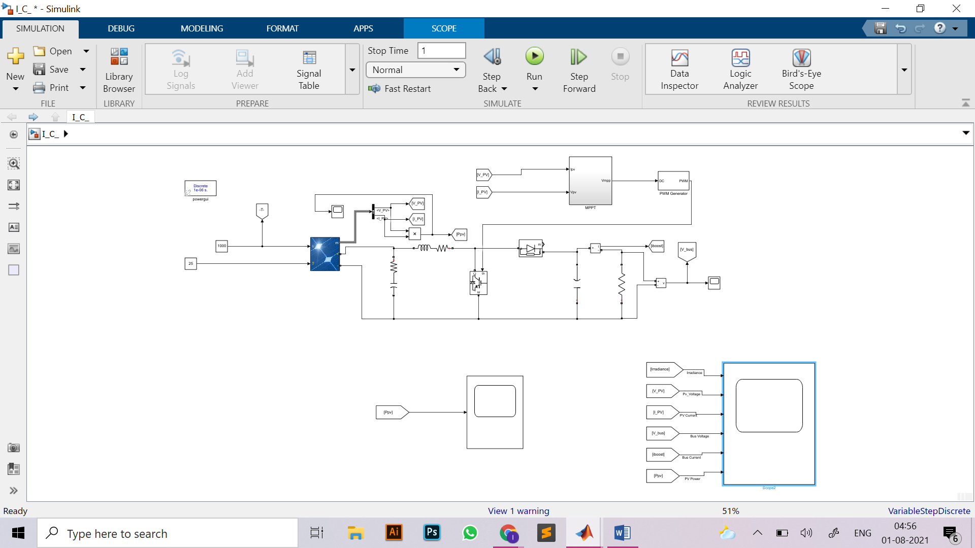
Project analysis slide 4
Matlab Implementation

Slide 12
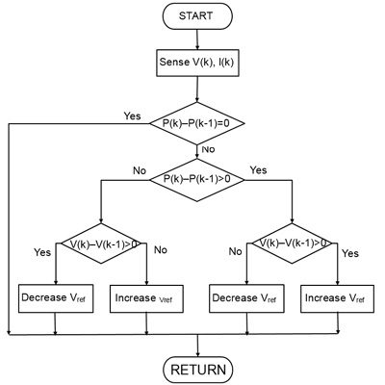
Project analysis slide 4
Perturbation and Observation (P&O)

Slide 13
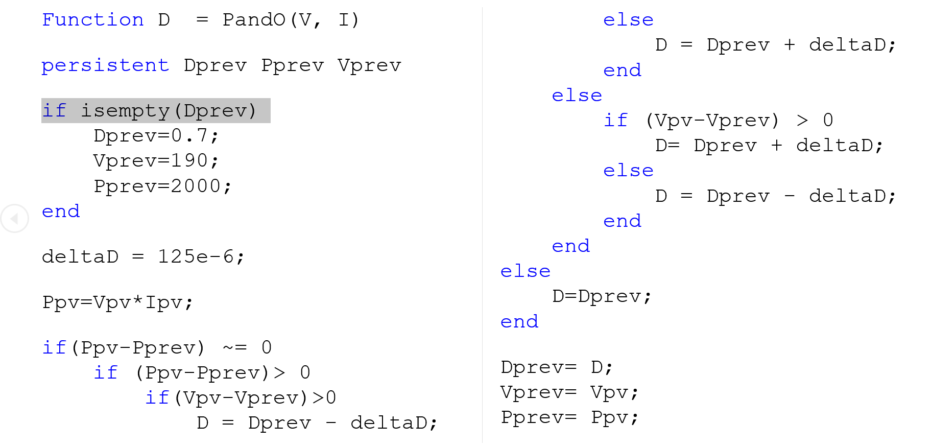
Project analysis slide 4
Code used

Slide 14
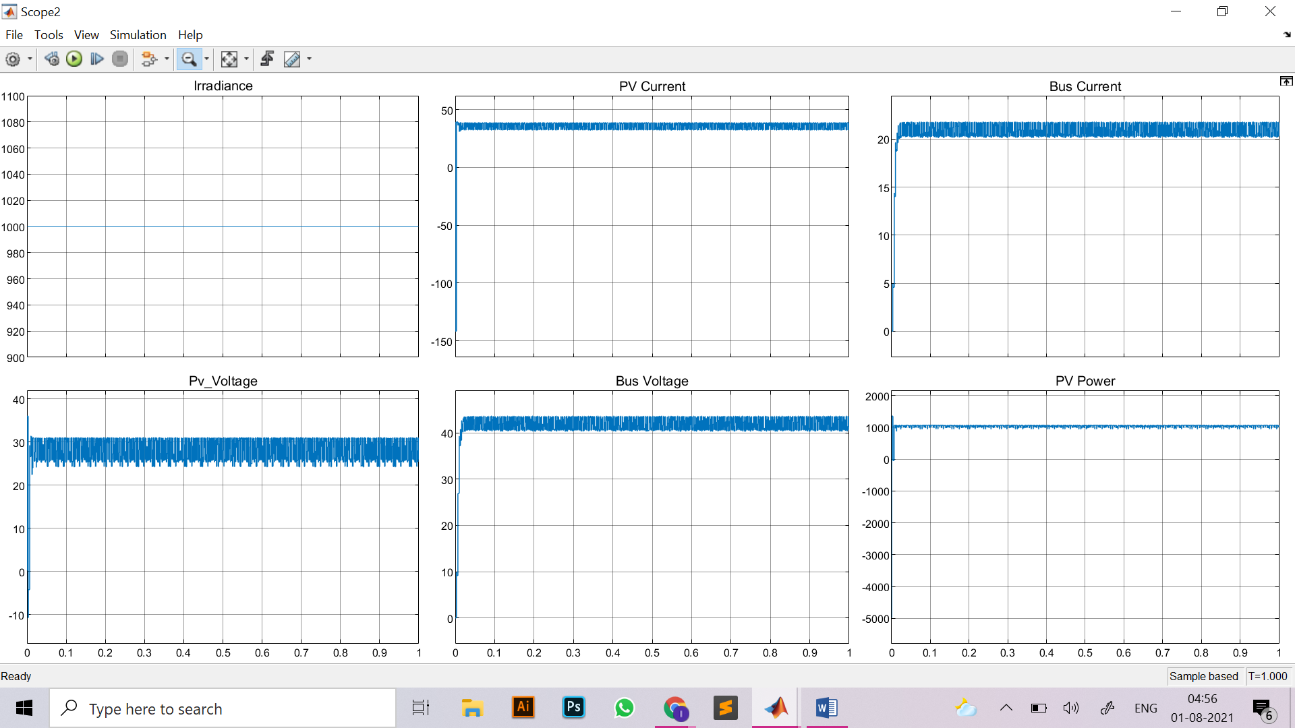
Project analysis slide 4
Results

Slide 15
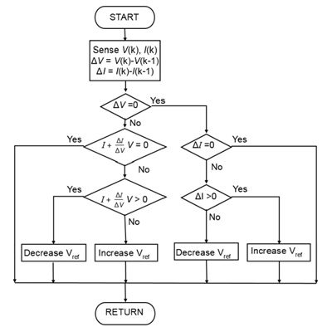
Project analysis slide 4
Incremental Conductance (IncCond)

Slide 16
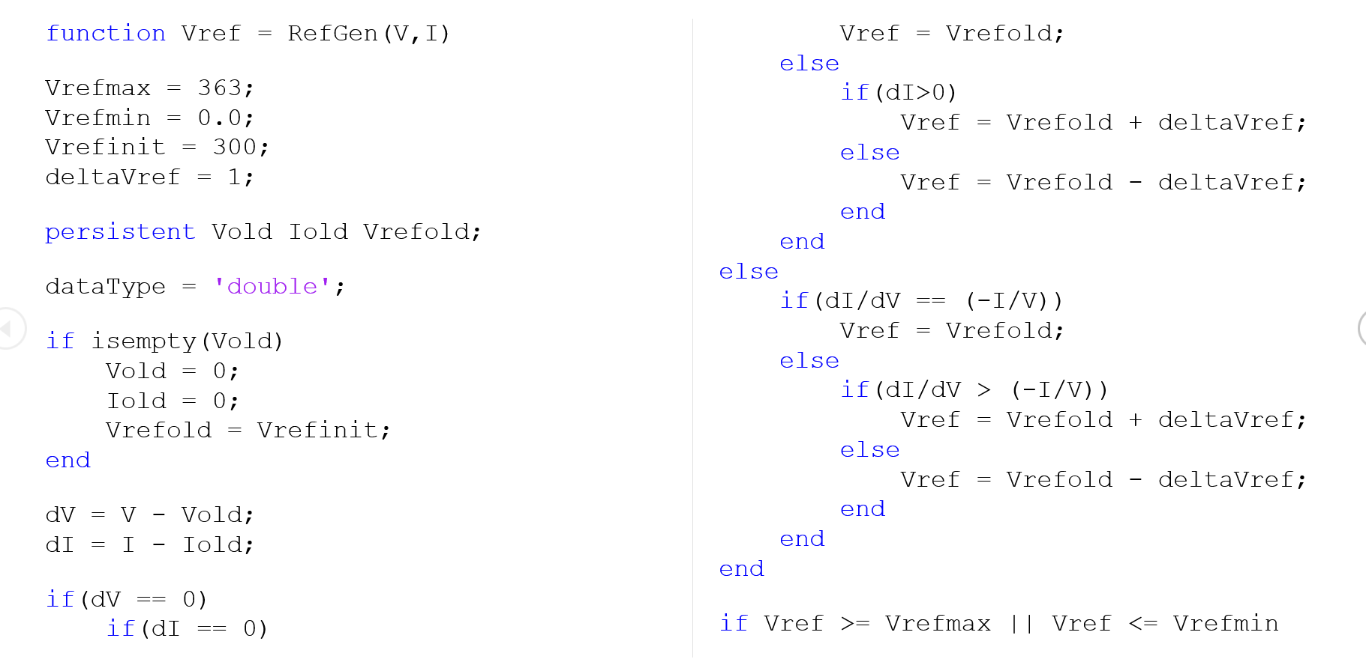
Project analysis slide 4
Code used

Slide 17
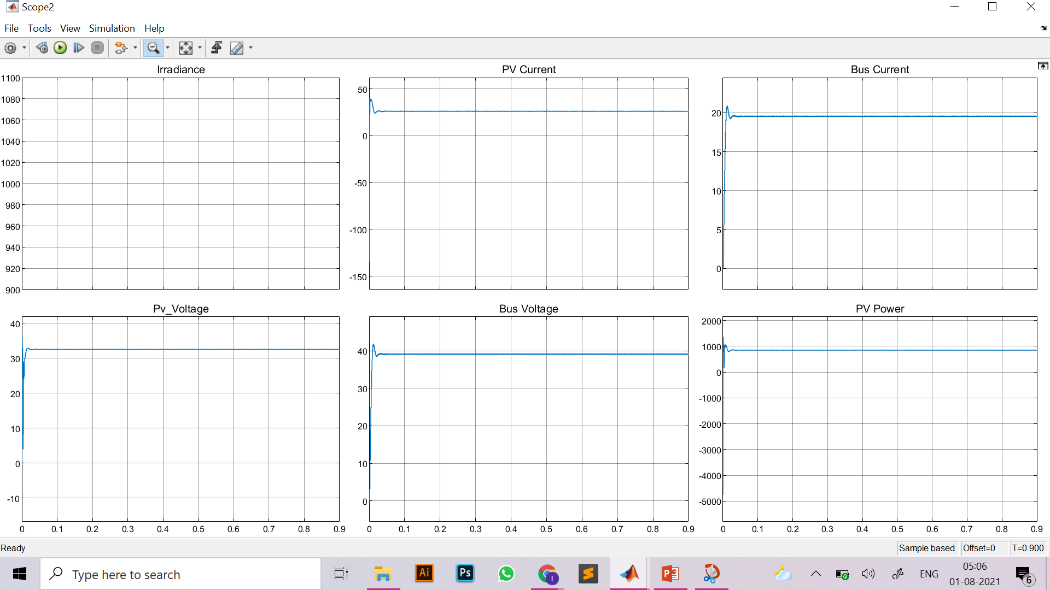
Project analysis slide 4
Results

Slide 18
MATLAB Implementation of Neural Network Based MPPT for Solar PV System

Slide 19
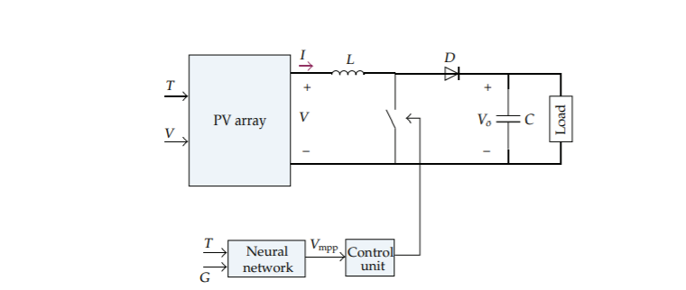
Project analysis slide 4
PV Circuit
The Neural Network will Receive 2 inputs
Temperature
Irradiance
And based on this the network will provide maximum voltage for maximum power point

Slide 20
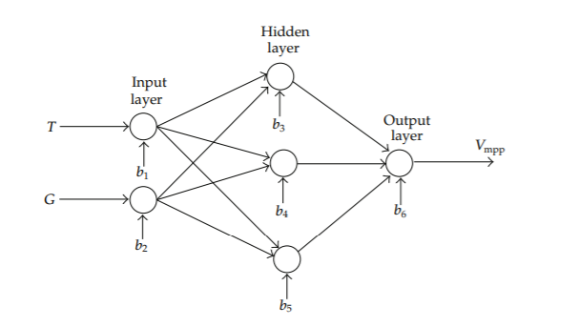
Project analysis slide 4
Neural Network Structure
A three-layer neural network is used to reach MPP
Temperature T and irradiance G are two input variables and voltage of MPP Vmpp is the output variable of ANN.
It is necessary to obtain some data as input and output variable to train the neural network
After training the ANN and specification of neuron weights, for any T and G as inputs of ANN, output of ANN is the Vmpp. Now, current of maximum power point Impp can be obtained by using V-I characteristic of the modeled PV. Consequently, maximum power Pmax is reached by multiplying Vmpp and Impp.

Slide 21
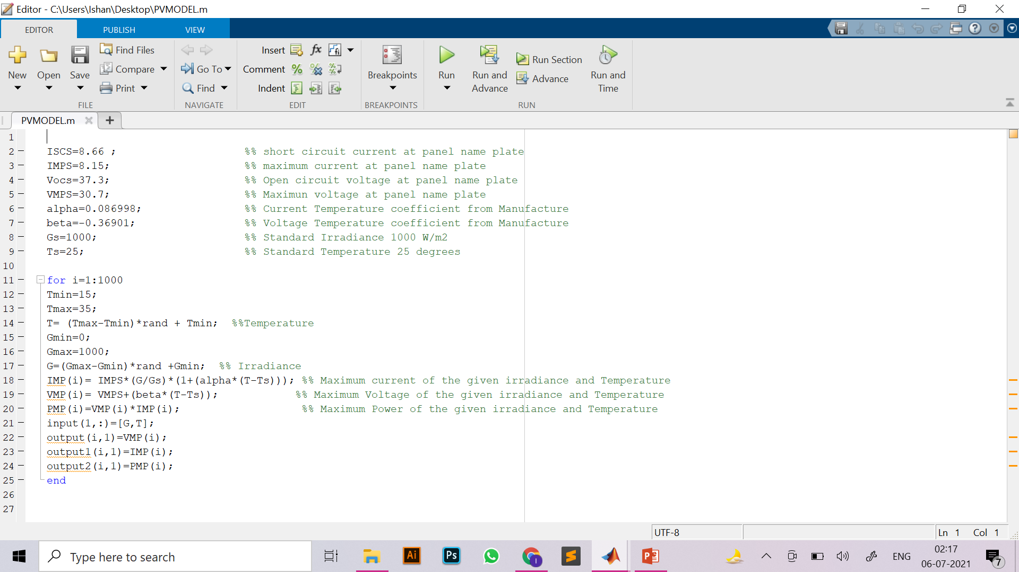
Project analysis slide 4
Collection of Data

Slide 22
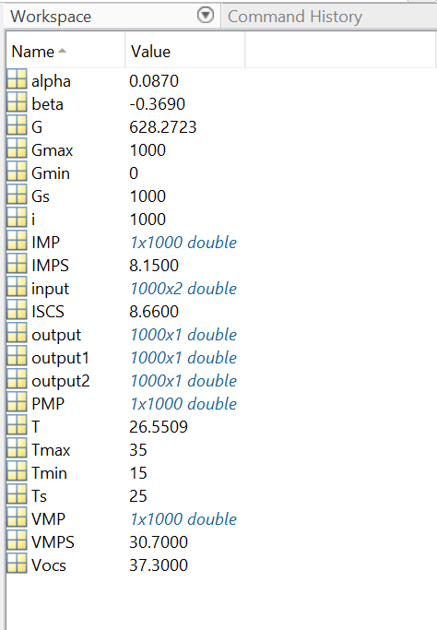
Project analysis slide 4
Collection of Data

Slide 23
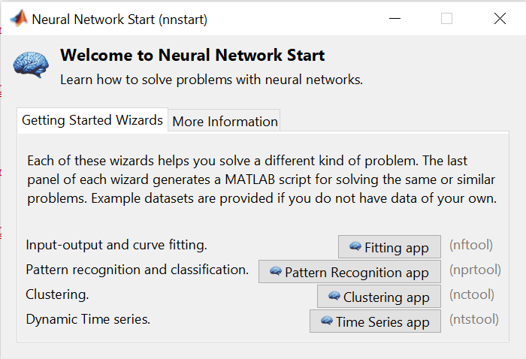
Project analysis slide 4
Training of Neural Network
1. nnstart

Slide 24
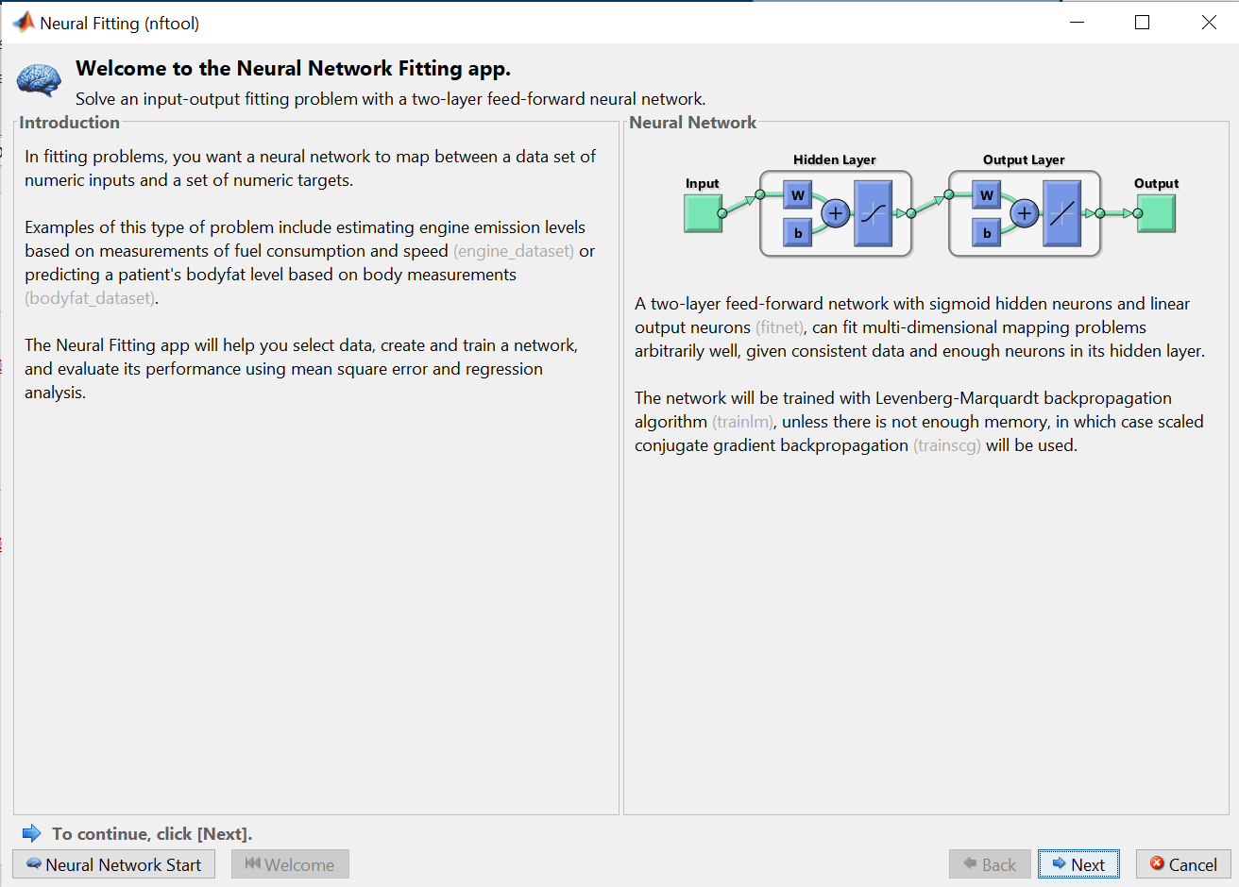
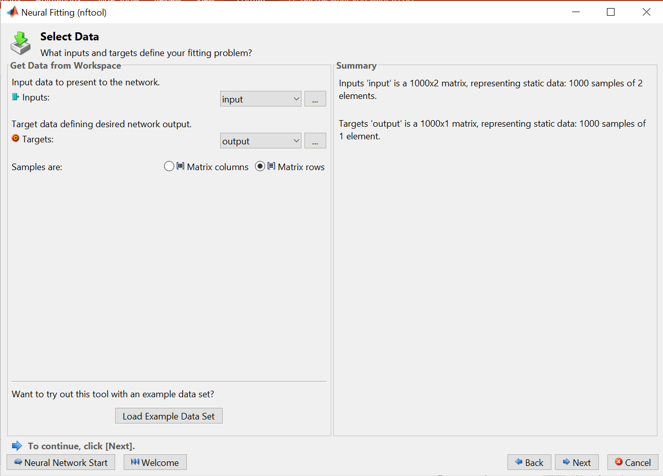
Project analysis slide 4
Training of Neural Network

Slide 25
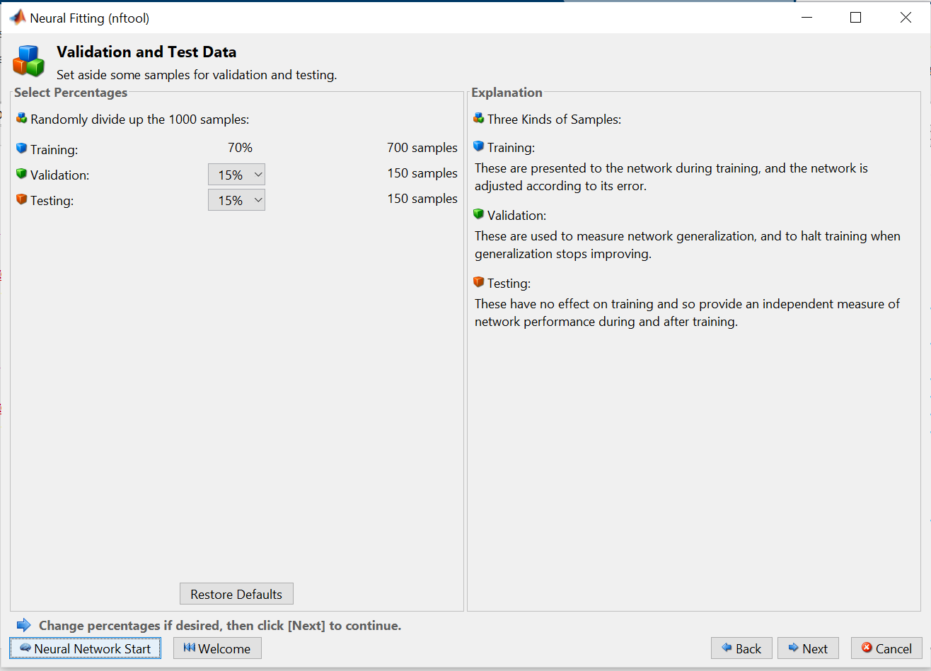
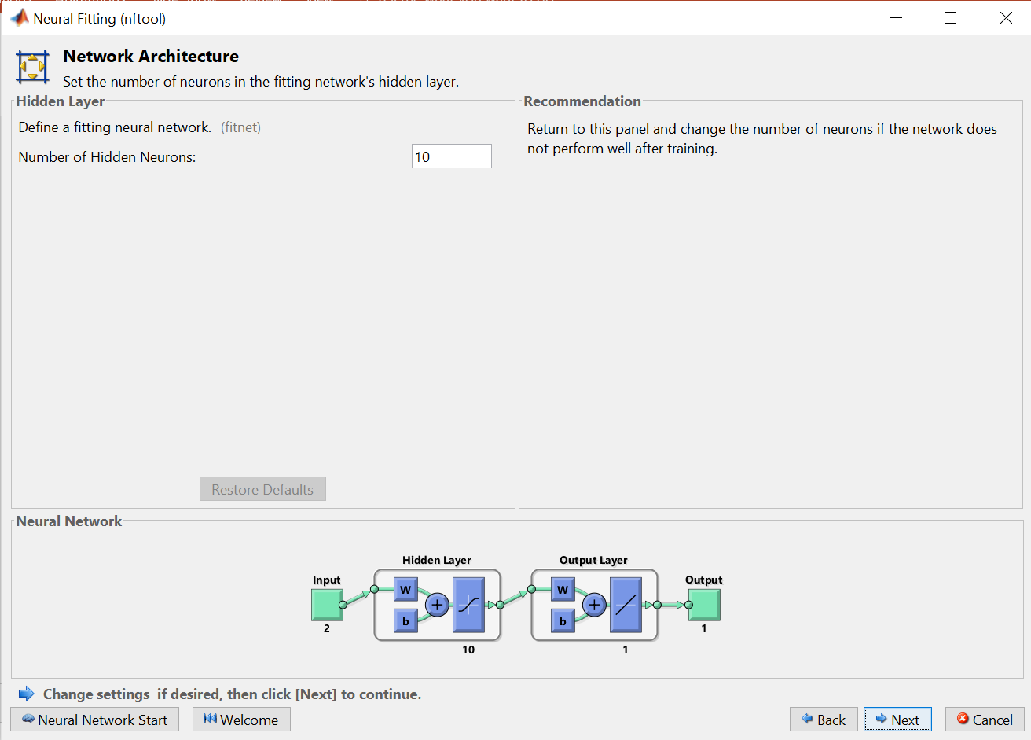
Project analysis slide 4
Training of Neural Network

Slide 26
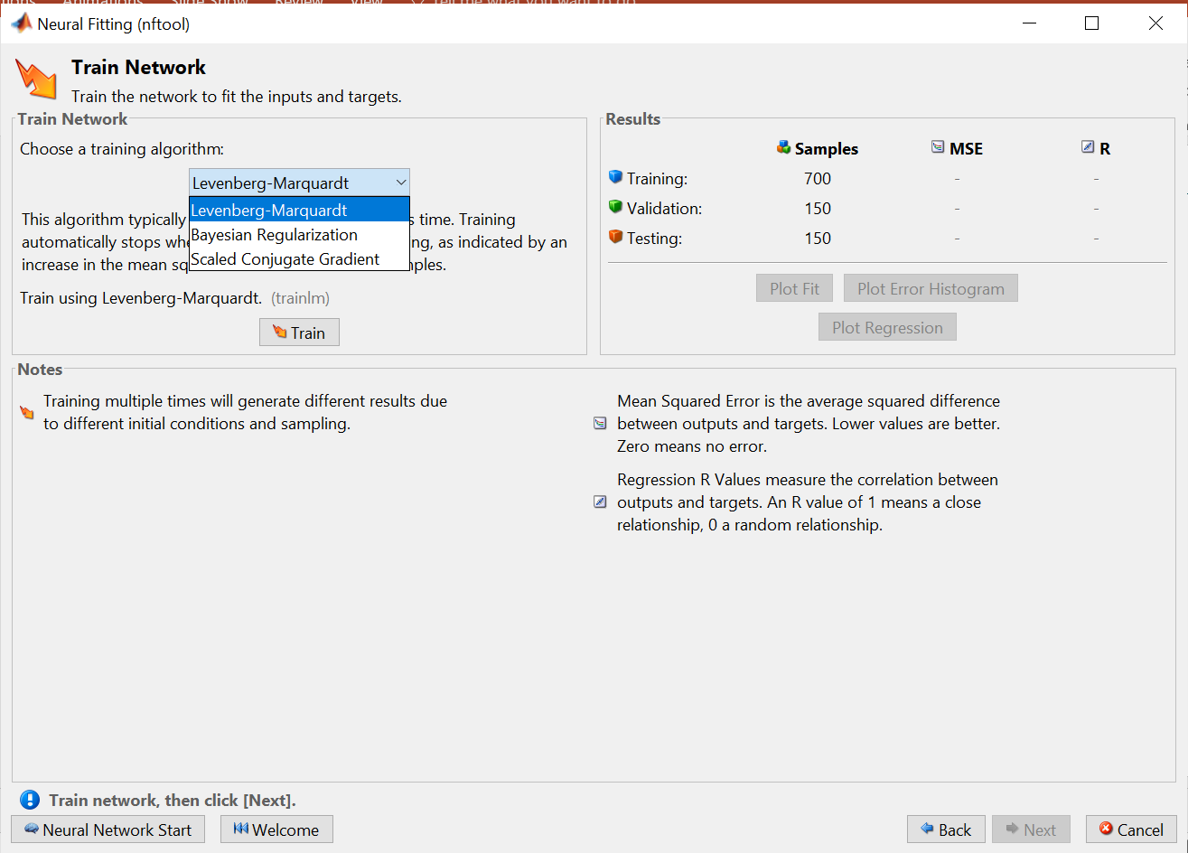
Project analysis slide 4
Training of Neural Network

Slide 27
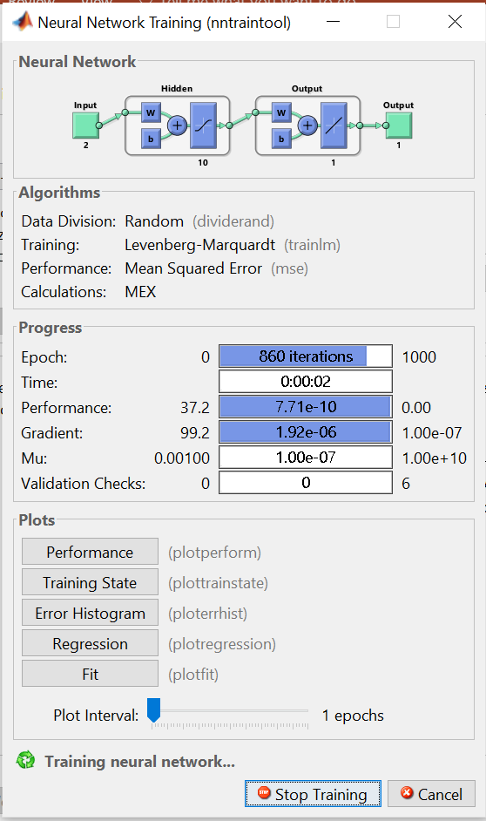
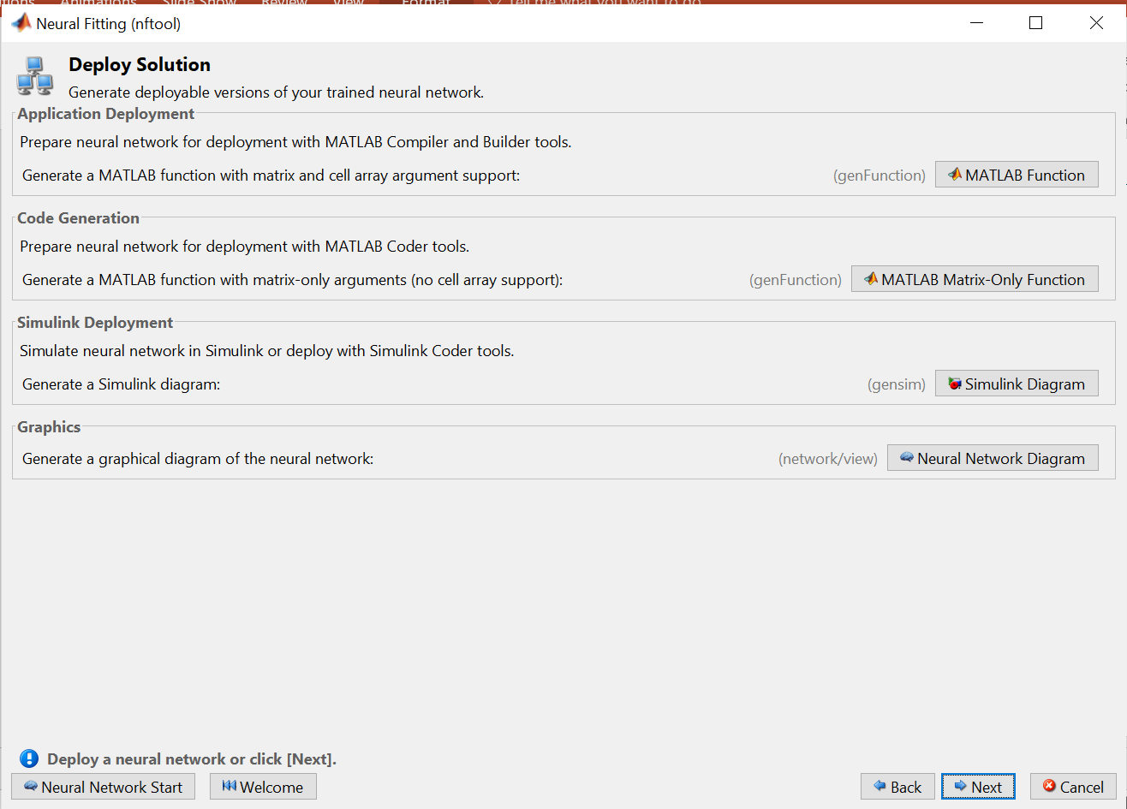
Project analysis slide 4
Training of Neural Network

Slide 28
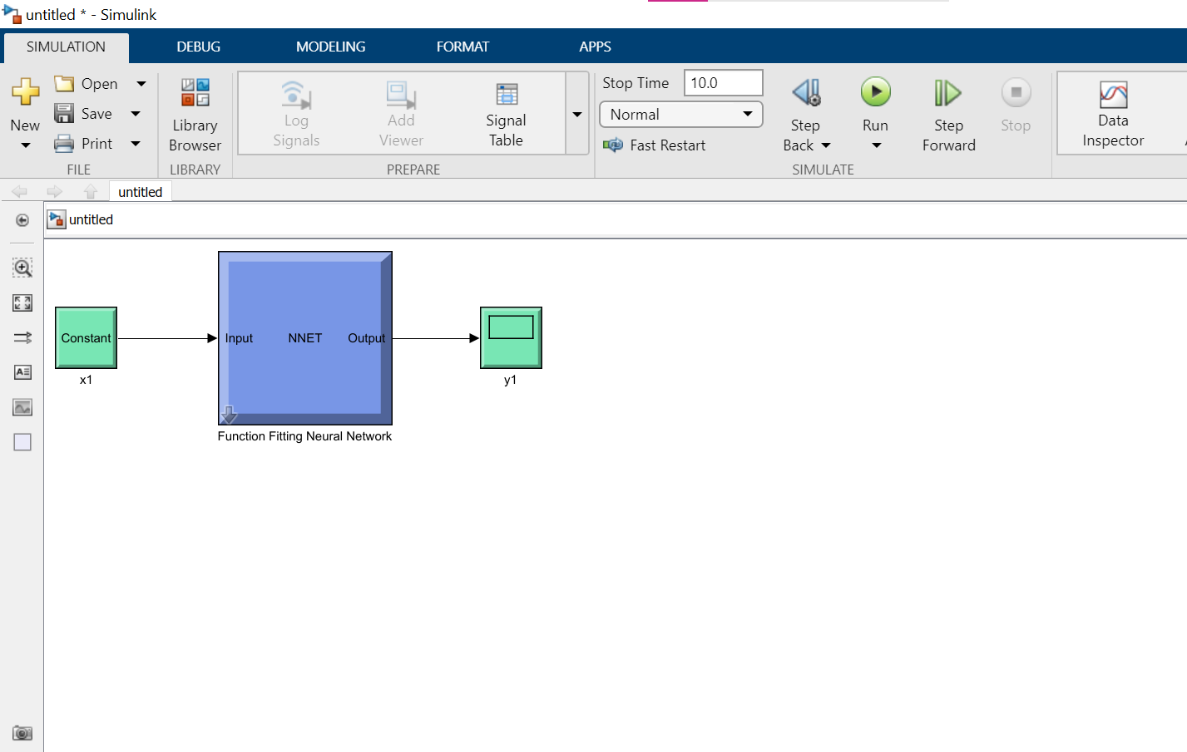
Project analysis slide 4
Training of Neural Network

Slide 29
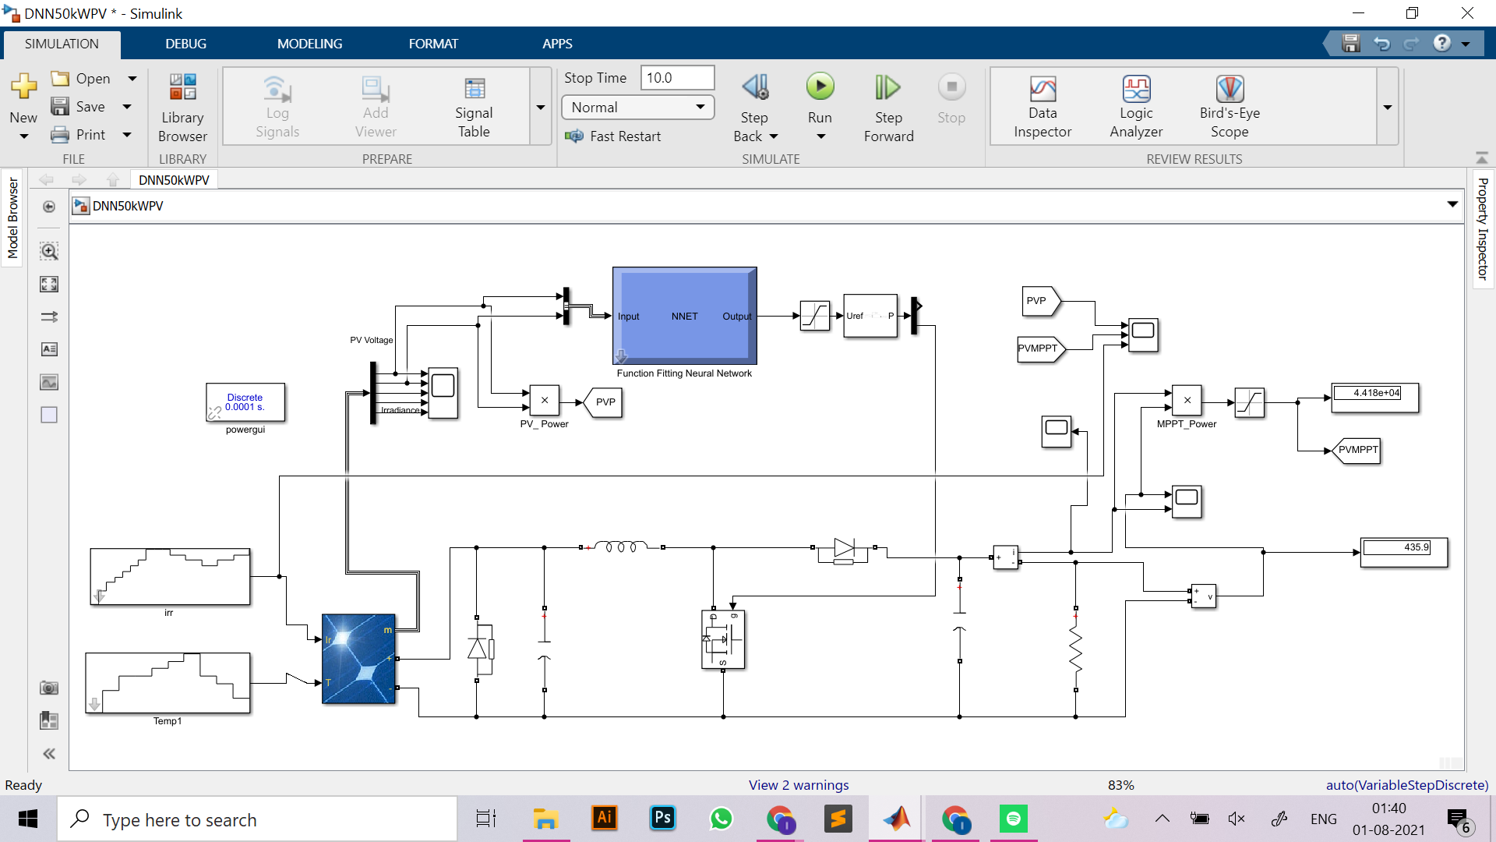
Project analysis slide 4
Matlab Implementation

Slide 30
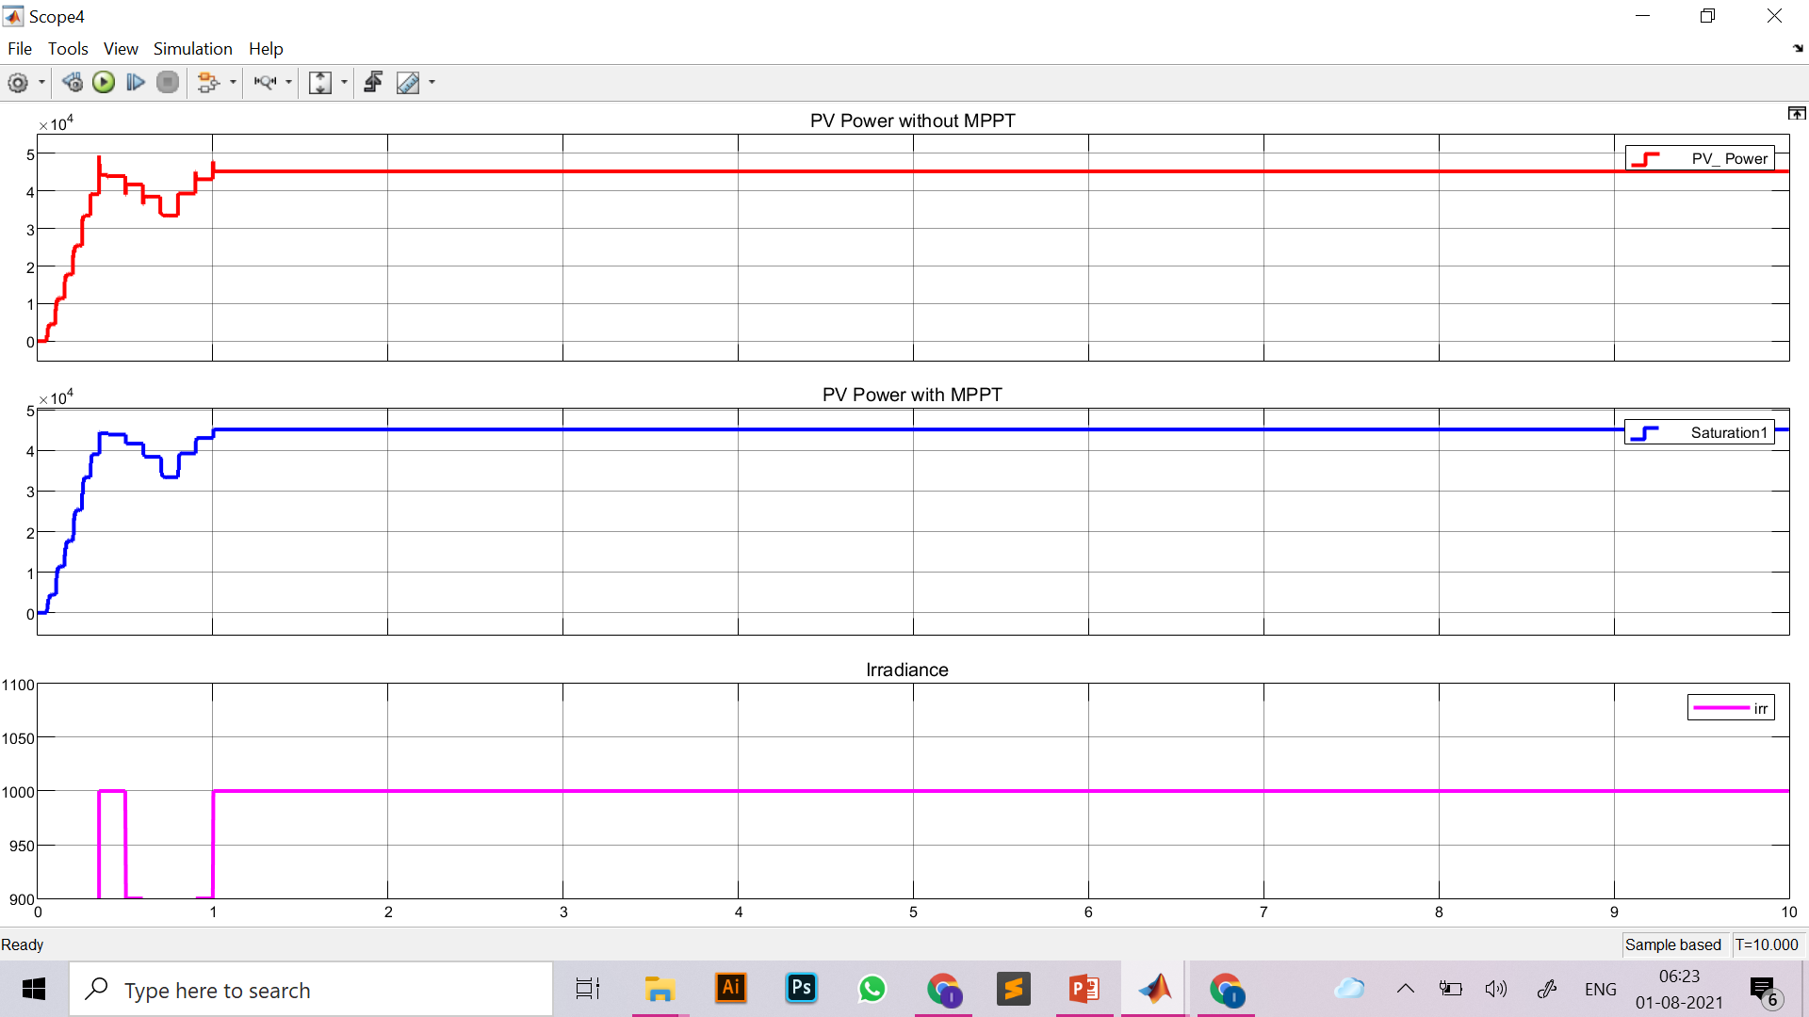
Project analysis slide 4
Results

